Slide 1
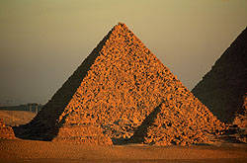
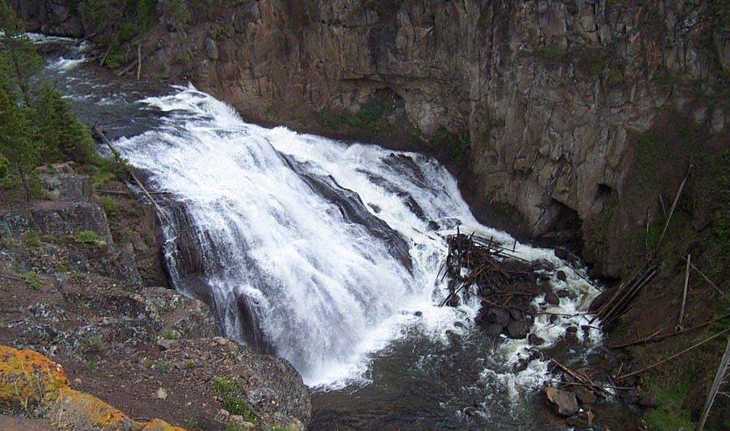
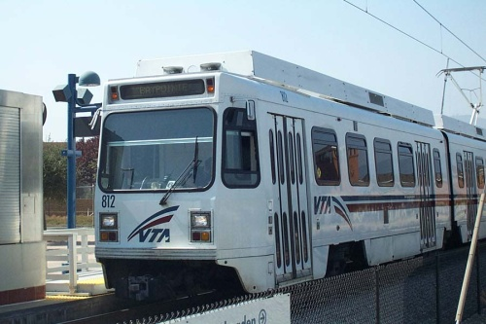
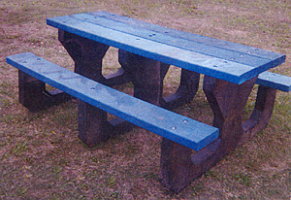
Introduction to Civil Engineering
prepaid by:
140670106002
140670106099
Notes:
This presentation introduces students to the field of Civil Engineering and the many different disciplines underneath that broad engineering umbrella. These pictures represent some of the areas of specialization. (Starting in the upper left and moving clockwise)
Structural engineers design buildings that are more robust to high magnitude earthquakes. The older, dark building suffered considerable damage to its upper floors while the lighter, new building remained intact.
This Egyptian pyramids demonstrate early expertise in construction engineering.
Among other achievements, environmental engineers have converted plastic waste into useful objects such as this picnic table.
Water resource and environmental engineers focus on conserving and reusing water, one of our most precious commodities.
Transportation engineers contribute to new and improved sources of public transportation

Slide 2
Learning Objectives
Understand how Civil Engineers impact lives
Identify some different areas of specialization
Understand job benefits
Identify necessary skills

Slide 3
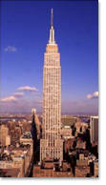
Civil Engineers
build structures that meet function, looks, cost, and reliability specifications
Notes:
Civil engineers work in many diversified fields. Their work is just about everywhere, from earthquake resistant buildings to advanced water treatment plants to public transportation systems.
The San Francisco Golden Gate Bridge and New York’s Empire State Building are a couple of notable examples of great construction projects. Not only do they fulfill some needs, but they do so with great beauty, were completed within a given budget, and have withstood variable loads (people, equipment, wind, storms, earthquakes, etc.) without catastrophic failure.

Slide 4
Civil Engineers
plan, design, and supervise construction of transportation systems, water systems, and communication networks
Notes:
Civil Engineers may concentrate on system design for a variety of applications. The map above shows the Santa Clara Valley Transportation Authority Light Rail routes. Civil engineers are involved in designating stop location positions, stop location design and construction, handicap access, parking, safety, evaluating traffic impact, and potential future expansion.

Slide 5
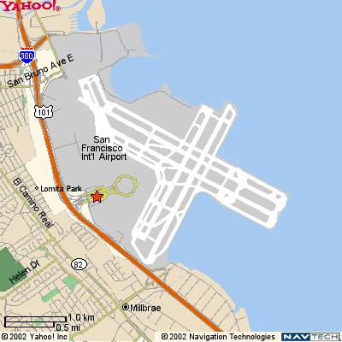
Civil Engineers...
solve local and regional pollution or environmental issues
Notes:
Civil engineers may concentrate on a variety of environmental issues. Due to space limitations in the surrounding area, San Francisco International Airport was constructed on landfill in the San Francisco Bay. Civil engineers worked with environmentalists to minimize the effects of this landfill solution besides designing the runways and terminal, evaluating freeway traffic patterns, and minimizing noise problems.

Slide 6
Major Areas of Specialization
Construction
Environmental
Geotechnical
Structural
Transportation
Water Resources

Slide 7
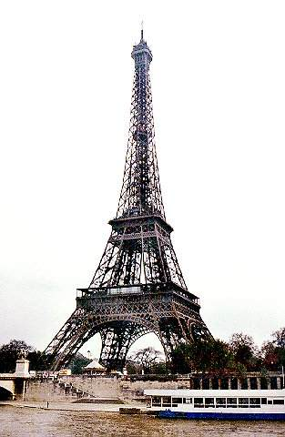
Construction Engineering
Required skills
methods and equipment
structures
construction management
cost estimation and analysis
Notes:
The civil engineer that specializes in construction must know various construction methods and the construction equipment required to build structures. The engineer must understand what the designer intended and how the structure best reflects the artistic message. The civil engineer must be a master at construction management since there are so many people involved in the construction process. And the civil engineer must be able to make accurate cost predictions to ensure the project is funded to completion while satisfying all the original specifications.

Slide 8
Environmental Engineering
Responsibilities include:
disposing hazardous materials
waste management and treatment
biological processes in pollution control
water and waste
water quality
Notes:
Environmental engineers work at minimizing or eliminating waste products without endangering the environment. They might engineer disposal techniques for hazardous materials. They might focus on pollution prevention or new pollution control processes.

Slide 9
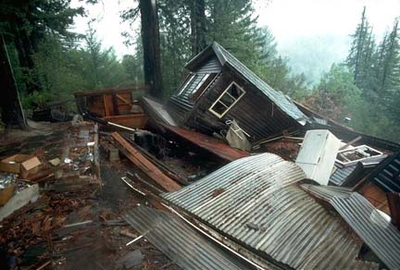
Geotechnical Engineering
Specializes in:
survey
soil mechanics and dynamics
earth structure
earthquake engineering
Don’t skip geotechnical analysis !
Notes:
A geotechnical civil engineer characterizes the land beneath a structure to ensure solid footing. For example, some areas have a ‘soft’ layer above the solid bedrock layer and pilings might have to be driven far into the earth to ensure a reliable support for a freeway overpass. Or as the picture indicates, mountainsides make for beautiful views but are not always stable for supporting a house. In this case, a high magnitude earthquake caused this mountainside house supports to give way and cause catastrophic failure.

Slide 10
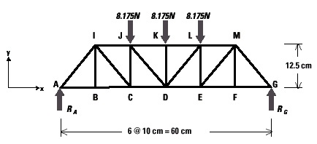
Structural Engineering
structural design and analysis
stress analysis
structure stability
seismic proof and reinforcement
Notes:
Structural engineering does analysis of the forces on a structure given specific applied loads. The bridge analysis above assumes the load is applied to the top chord of the bridge over the center three vertical supports. Much of today’s structural engineering is supported by computer simulation.
The above bridge analysis will be done by the students later in this module. They will also get to use a computer simulator and calculate the factor of safety in the design.

Slide 11
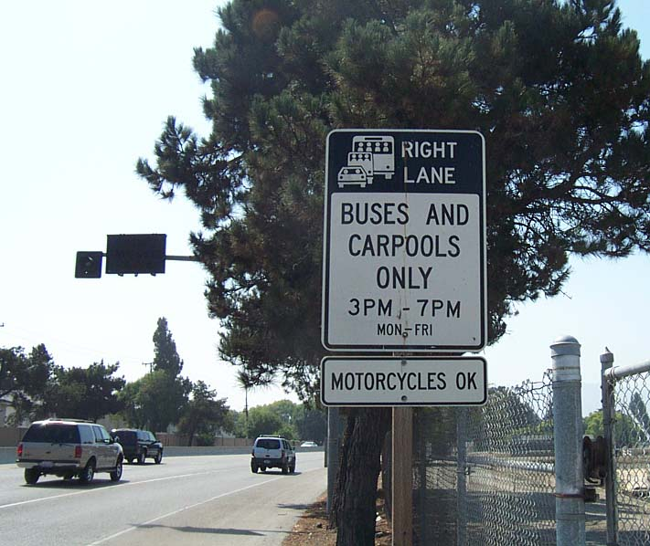
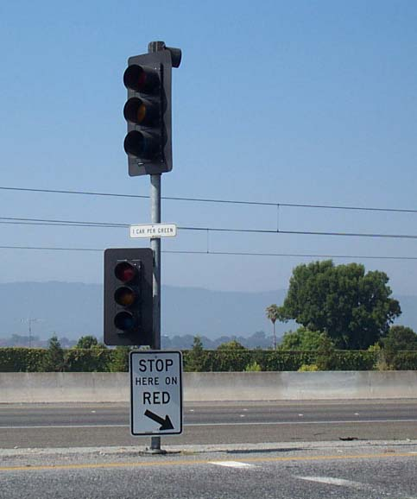
Transportation Engineering
Responsible for public transportation systems, traffic operations, highways and streets
Notes:
The two pictures show how California transportation engineers help control roadway congestion. To encourage carpooling, one lane of a highly traveled commuter road may be designated as a carpool lane (two or more passengers) during peak traffic times. The second pictures shows a metered freeway onramp that constricts merging traffic so the freeway traffic continually flows.

Slide 12
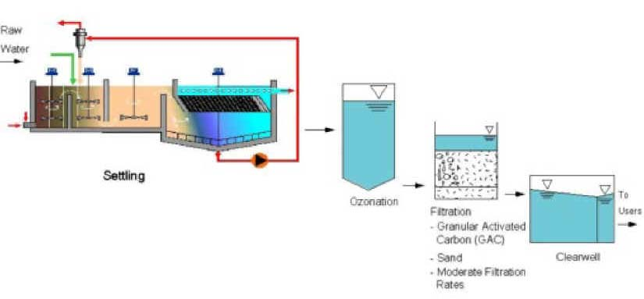
Water Resource Engineering
Responsibilities include water treatment processes, waste water management, ground water resources, sediment transport , environmental engineering and systems
Water treatment plant flow chart
Notes:
This is similar to environmental engineering, but concentrates only on water issues. Water is one of our most precious resources and the civil engineer must maximize water usage efficiency without endangering man or the environment.
Students might be squeamish, but this water treatment plant takes care of all material that is flushed, dumped, or poured down the drain. The output of this plant is either safe water released back to the environment, farm fertilizer, or neutralized landfill waste. Read the three page Water Treatment Article for solid background.

Slide 13
Civil Engineering Benefits
Solve societal problems
Allows indoor and outdoor work
Responsible, highly respected job
Challenging technical career
Utilize modern technology
Work with people of various backgrounds
Well paid

Slide 14
Skills to Develop
Math and Science
Algebra, trigonometry, analytical geometry, and calculus
Physics, chemistry
Computer languages
Communication Skills
Written English
Speech and presentation skills
Foreign Language

